Slide 1
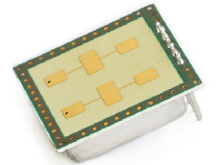

Option Dielectric Lens Antenna
broad radar-beam
short range
24 GHz
Range
24 GHz
small radar-beam
long range
dielectric lens (3D printed)
design with ordinary formulas from optics
R.J. Friel et al., ”3D Printed Radar Lenses with Anti-Reflective Structures”, MDPI, 2019.

Slide 2
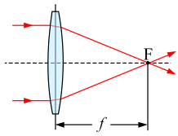
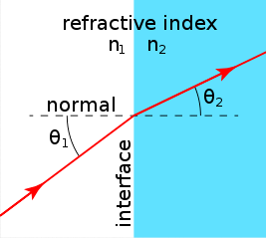
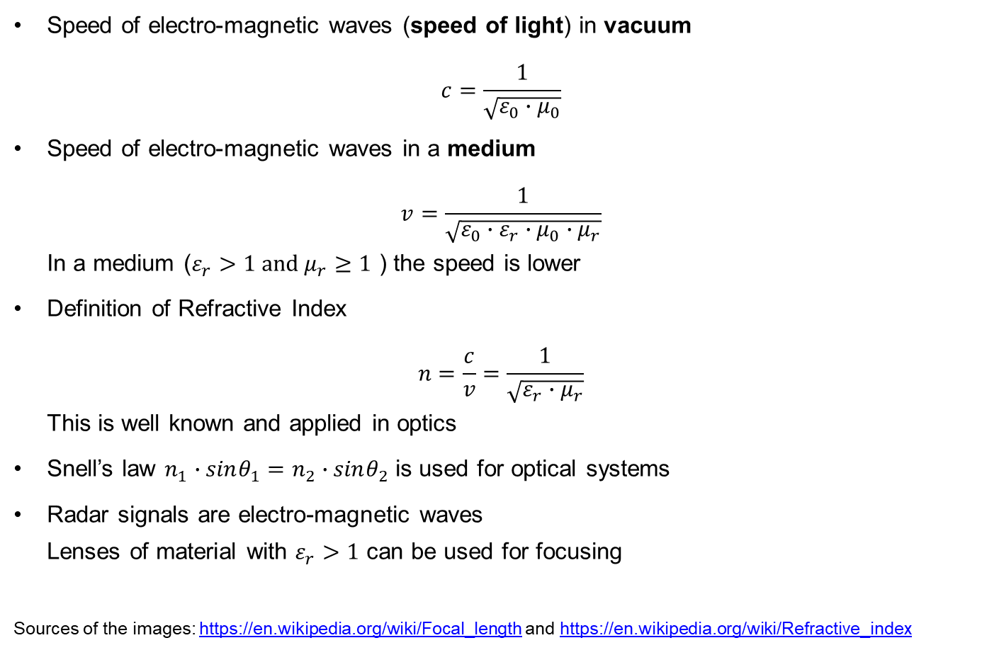
Speed of Light and Refractive Index
Speed of electro-magnetic waves (speed of light) in vacuum
$c=\frac{1}{\sqrt{ε_{0}∙μ_{0}}}$
Speed of electro-magnetic waves in a medium
$v=\frac{1}{\sqrt{ε_{0}∙ε_{r}∙μ_{0}∙μ_{r}}}$
In a medium ($ε_{r}>1 \text{and} μ_{r}≥1$ ) the speed is lower
Definition of Refractive Index
$n=\frac{c}{v}=\frac{1}{\sqrt{ε_{r}∙μ_{r}}}$
This is well known and applied in optics
Snell’s law $n_{1}∙sinθ_{1}=n_{2}∙sinθ_{2}$ is used for optical systems
Radar signals are electro-magnetic waves
Lenses of material with $ε_{r}>1$ can be used for focusing
Sources of the images: https://en.wikipedia.org/wiki/Focal_length and https://en.wikipedia.org/wiki/Refractive_index

